Slide 1

Database Integrity
By
Ibtisam Mogul

Slide 2
References
Ian. (2018)What is referential Integrity? [Online] Available from: https://database.guide/what-is-referential-integrity/. [Accessed 1 November 2018].
Microsoft. (unknown) Restrict data input by using validation rules. Available from: https://support.office.com/en-us/article/restrict-data-input-by-using-validation-rules-b91c6b15-bcd3-42c1-90bf-e3a0272e988d.
[Accessed 10 October 2017].
Oracle. (2018) Data Integrity. [Online] Available from: https://docs.oracle.com/cd/B19306_01/server.102/b14220/data_int.htm. [Accessed 1 November 2018].
University of California. (2002) Database Administration: Security and Integrity. [Online] Available from: courses.ischool.berkeley.edu/i257/s04/Lectures/Lecture16_257.ppt.
[Accessed 10 October 2017].
9experttraining. (unknown) Integrity Constraints. [Online] Available from: https://www.9experttraining.com/articles/Integrity-constraints. [Accessed 2 November 2018].

Slide 3
Overview
MSAccess
Integrity Constraints
Required Data
Domain Constraints
Entity Integrity
Enterprise Constraints
Referential Integrity
Unique Key

Slide 4


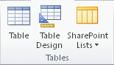



MSAccess
Creating a Database
Creating a Table
Adding Fields/Attributes/ Columns
Primary Key
Types of Views:
Design View
Datasheet View
Notes:
https://support.office.com/en-us/article/Restrict-data-input-by-using-validation-rules-b91c6b15-bcd3-42c1-90bf-e3a0272e988d#__toc295389823
https://support.office.com/en-us/article/Create-a-relationship-40c998dd-4875-4da4-98c8-8ac8f109b85b

Slide 5
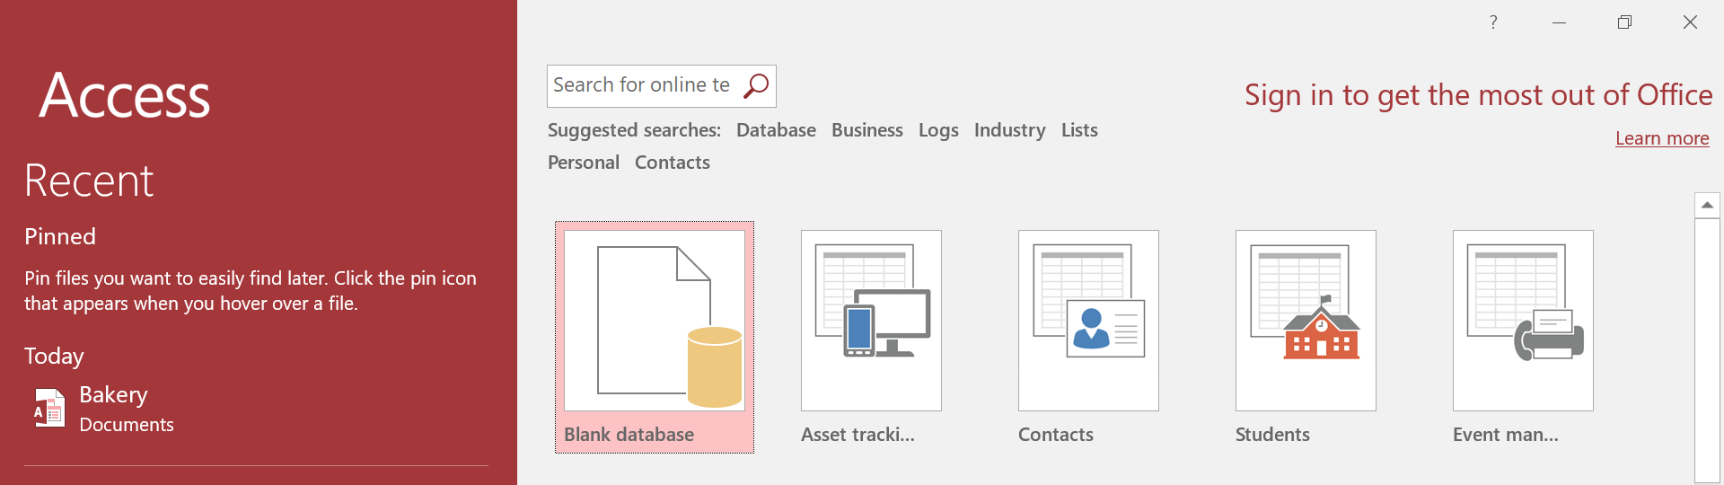
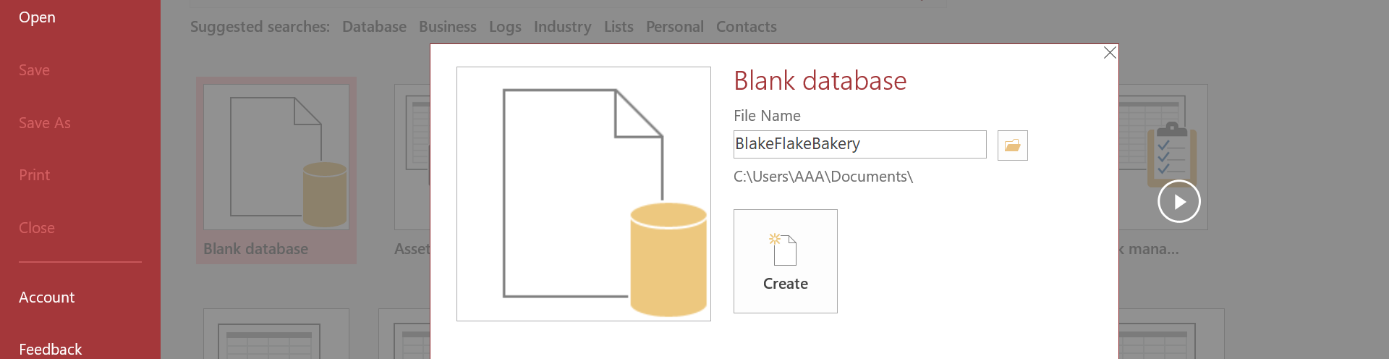
I. Create New database
File name should be given as Name of Database and click Create
Eg: Cakes&CrumbsBakery

Slide 6
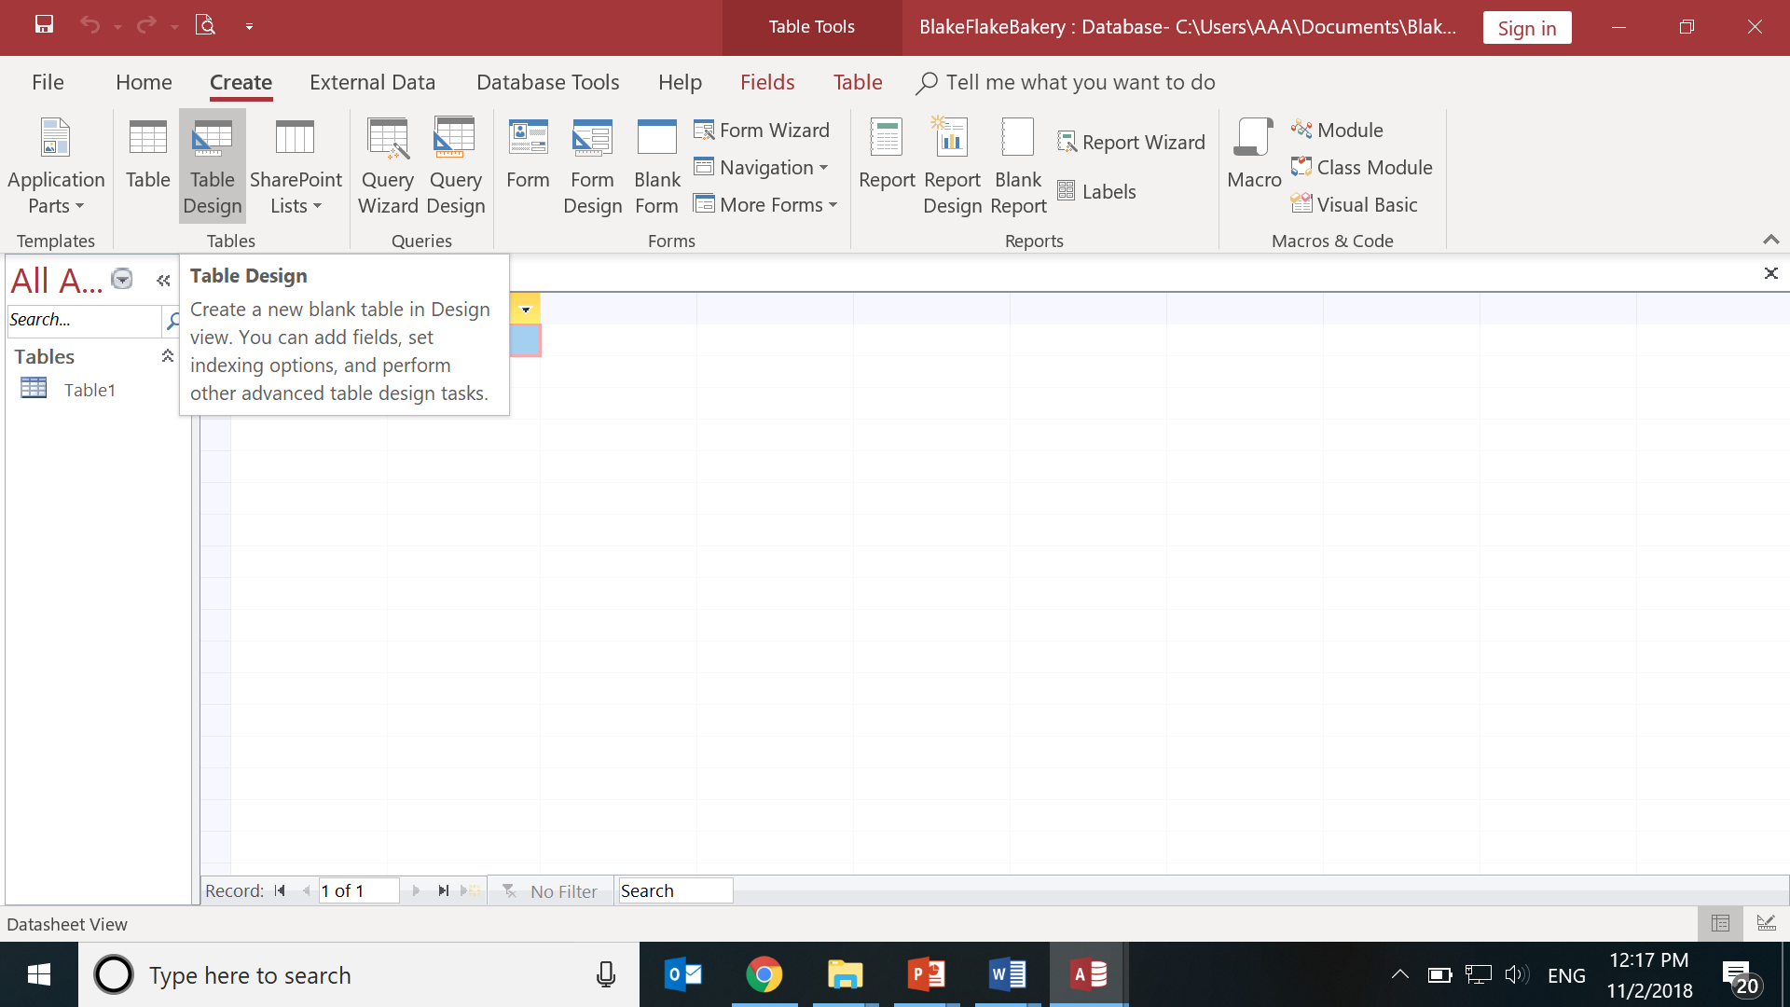
II. Creating Table
Tab on Top>Create tab,
Section-> Tables,
Click Table Design.
Access creates the table
and selects the first empty cell in the Click to Add column.

Slide 7
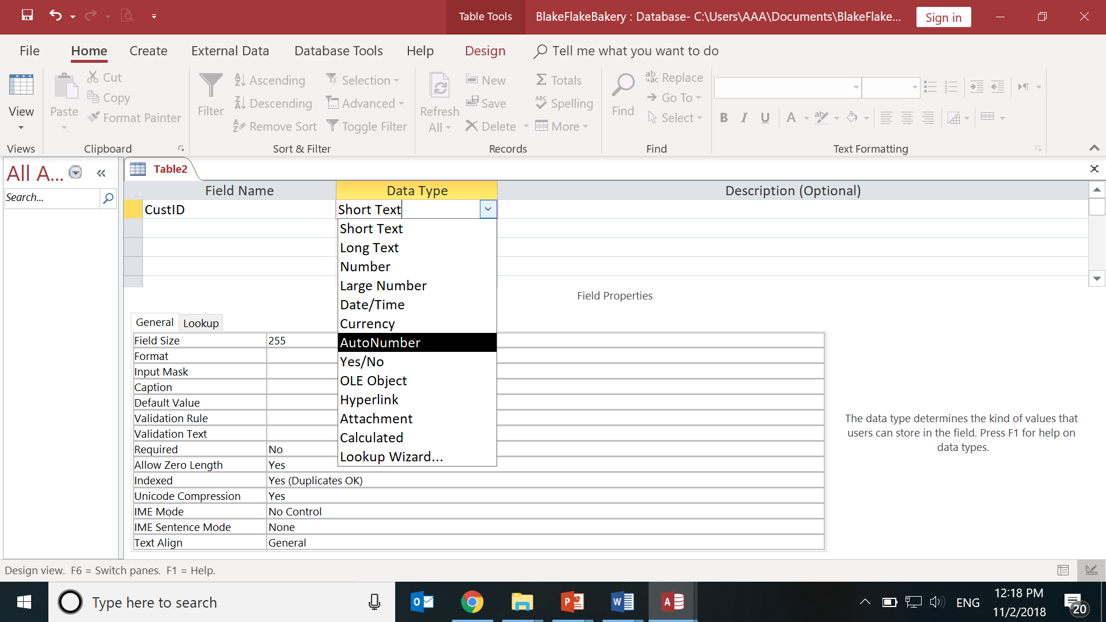
III. Adding a Column/Field/Attribute
Fields Name column-> Type Attribute name(eg: CustID)
Data Type column-> Select its type(Autonumber)

Slide 8
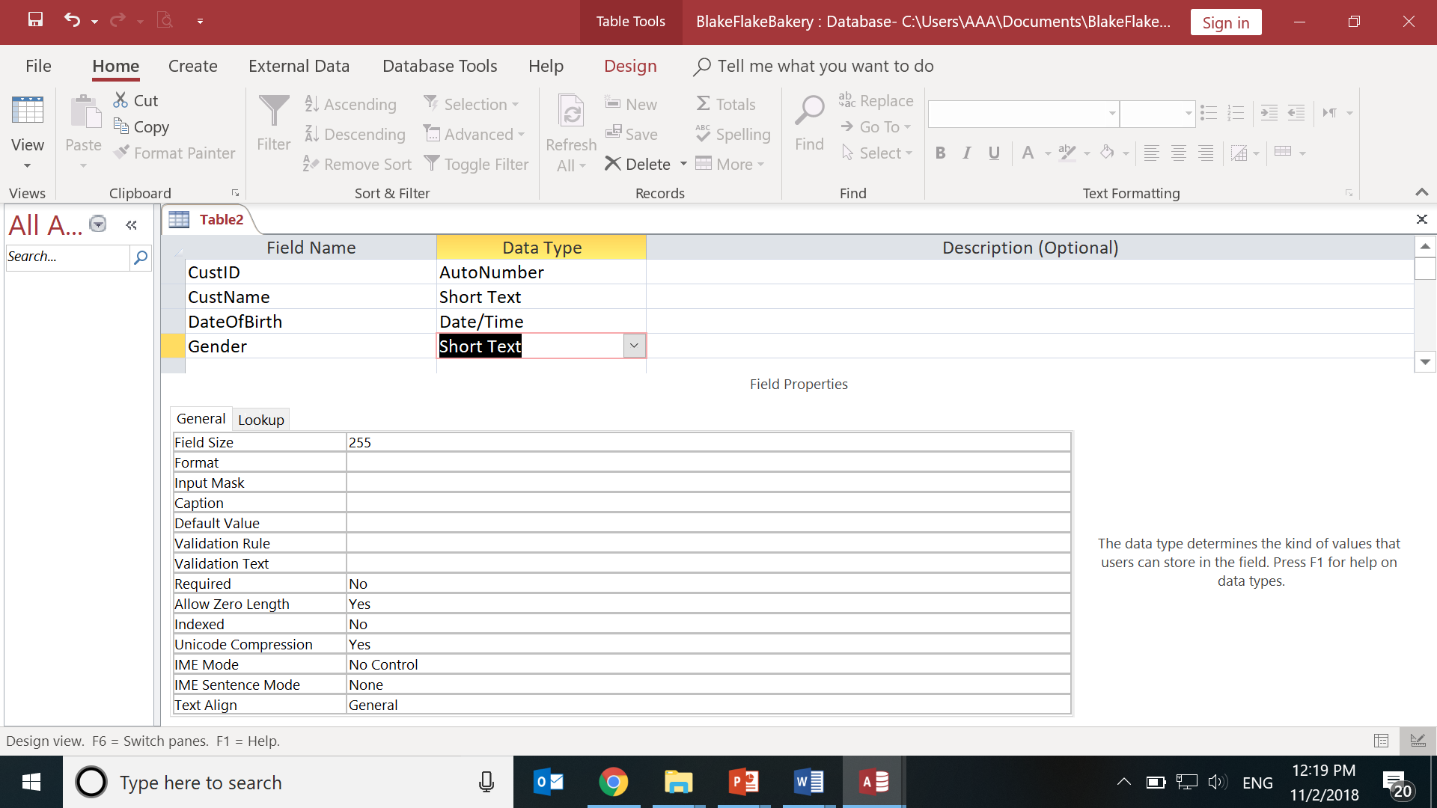
Adding other attributes/fields

Slide 9
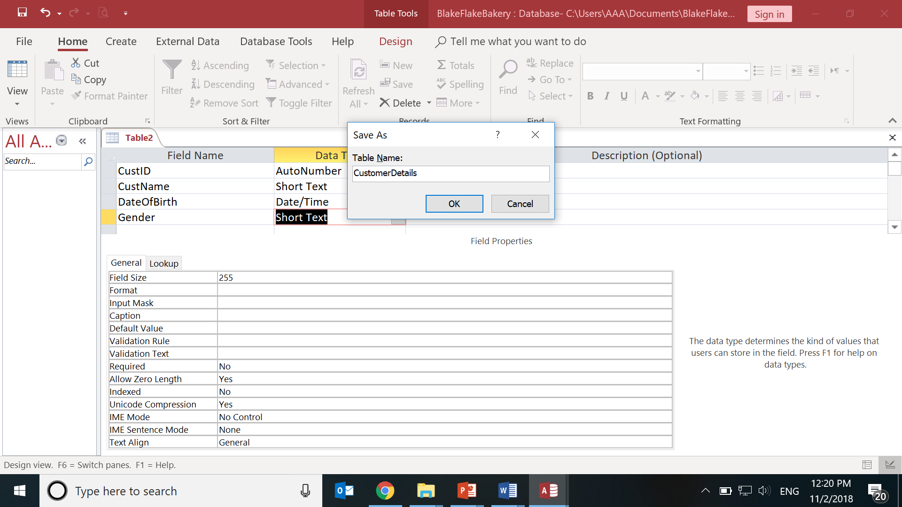
Name the Table
Press Cntrl+S to save
Type Table Name : CustomerDetails and click OK

Slide 10
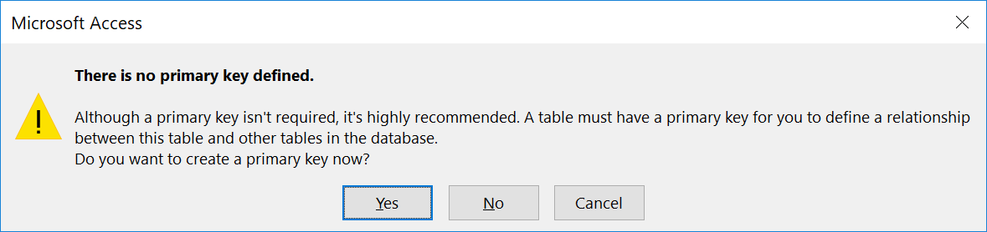
IV. Setting the Primary Key
Select Yes.

Slide 11
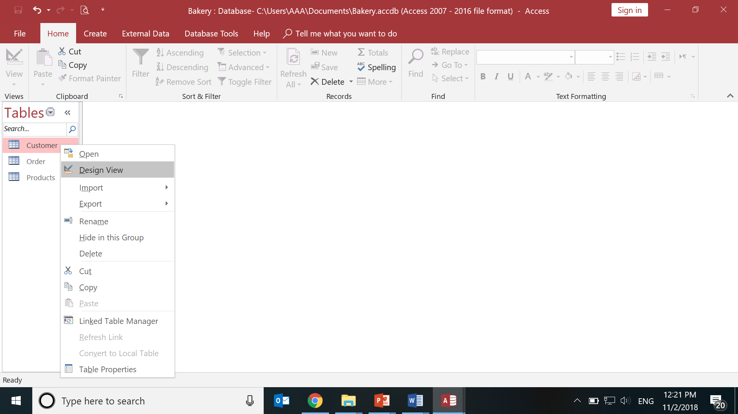
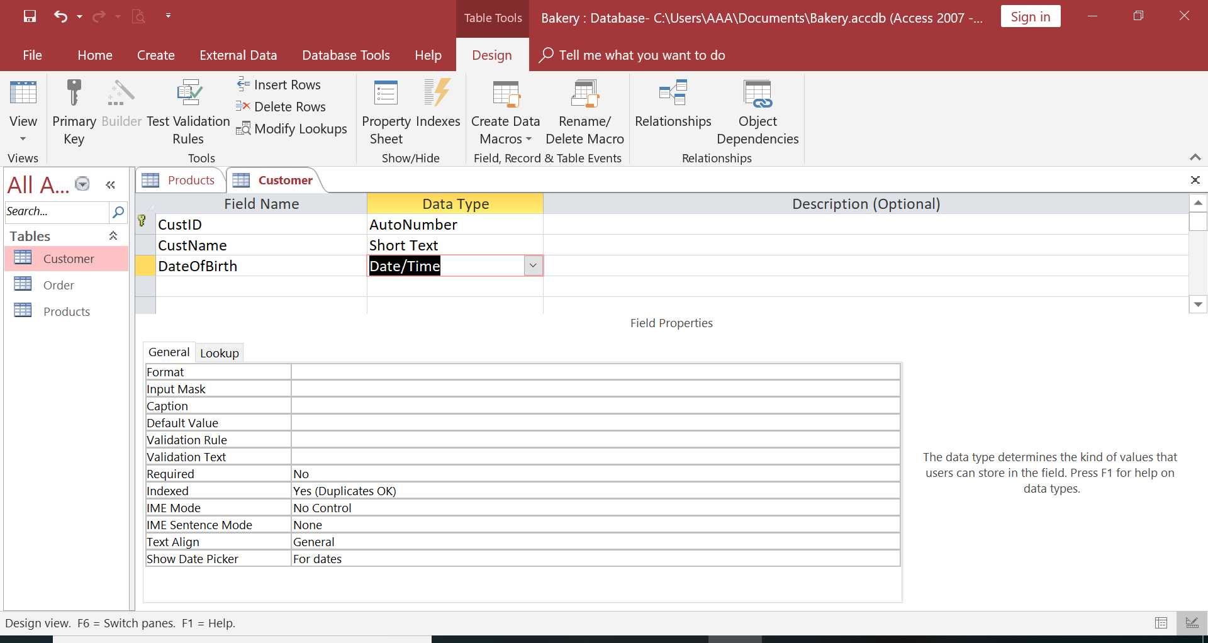
V. A-Design View
Design View helps to view/modify
structure of the table.
Right click Table Customer in Left Object Explorer
Select Design View

Slide 12
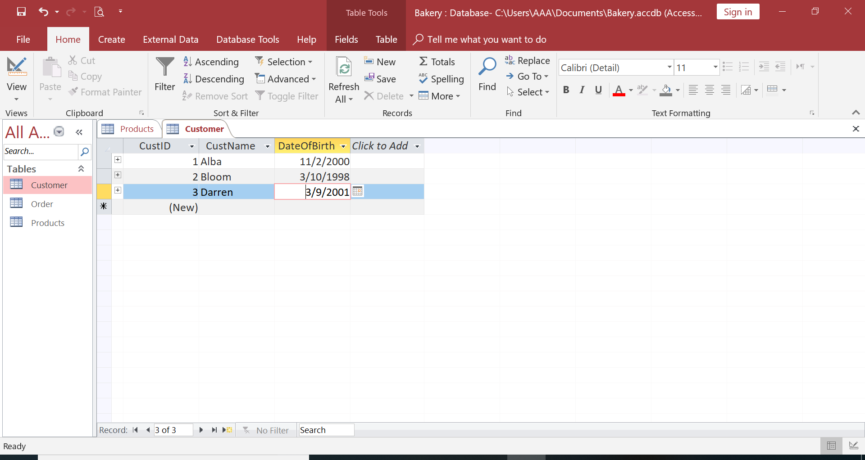
V. B. DataSheet View Input Data in the Table
Datasheet View- Displays/Manipulates data.
Double Click the Table(eg: Customer) in the Object Explorer.
Enter Data( Only CustName and DateOfBirth NOT CustID)

Slide 13
Activity: Product Table
Create Table Product
Field and Domain
ProdID -> AutoNumber
ProdName -> ShortText
Prod_PricePer -> Number
Enter Details

Slide 14
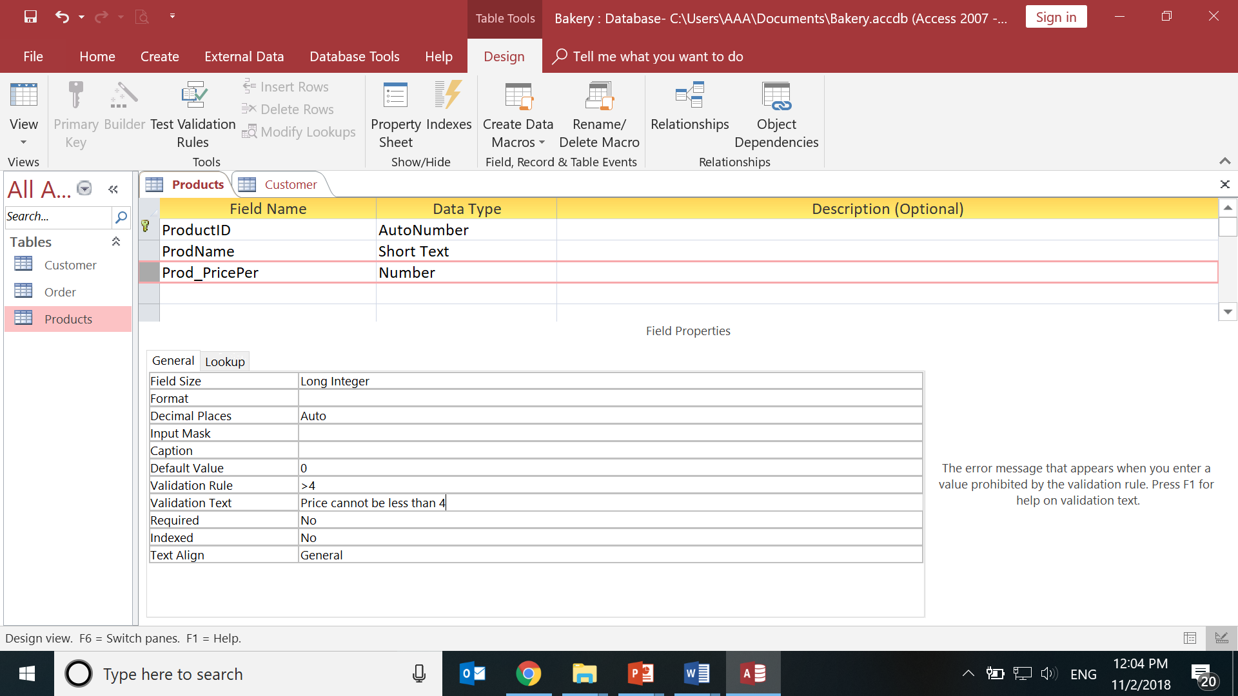
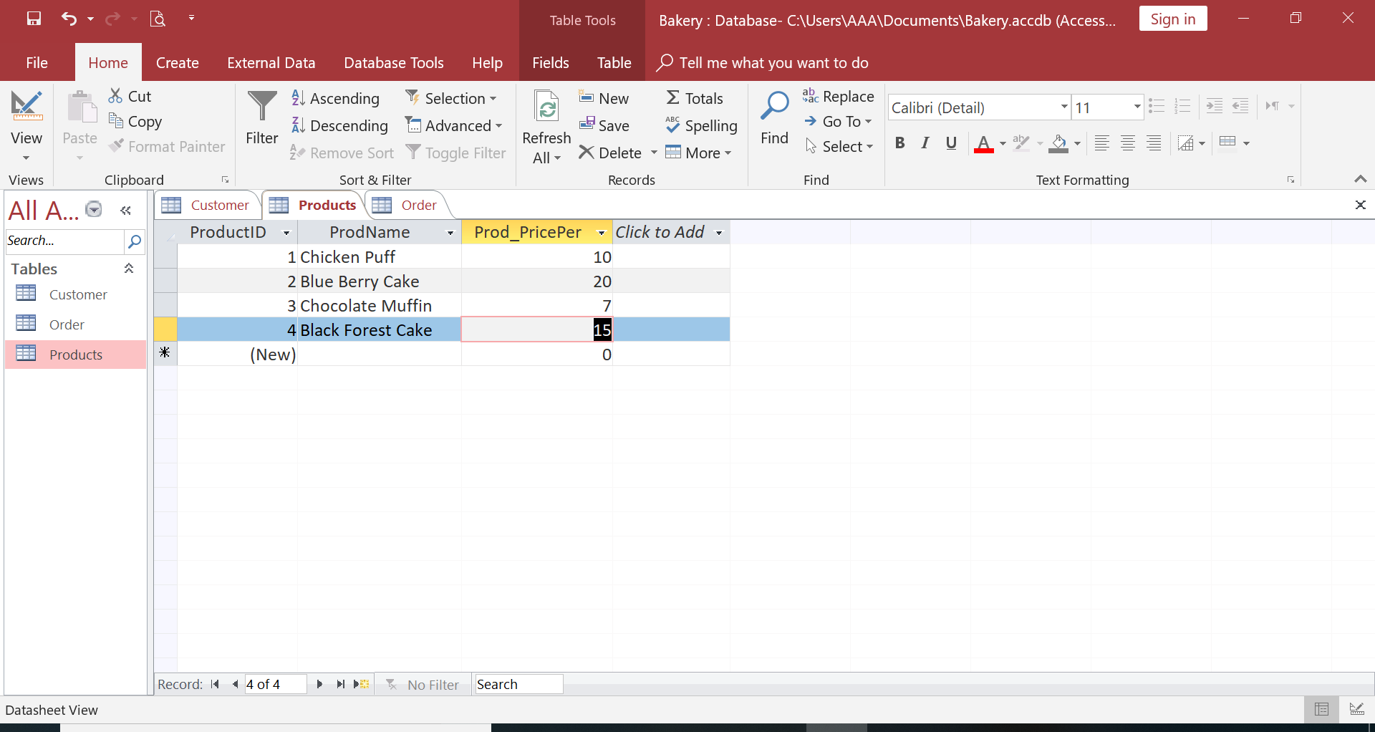

Slide 15
Integrity Constraints

Slide 16
Database Constraints
Database constraints are restrictions
on the contents of the database or
on database operations
DB constraints guarantee that:
rows in a table have valid primary or unique key values
rows in a dependent table have valid foreign key values that reference rows in a parent table
individual column values are valid

Slide 17
Integrity Constraints (contd..)
Integrity Constraints-The constraints we wish to impose
Why???
in order to protect the database from becoming inconsistent.
Integrity constraints guard against accidental damage to the database,
by ensuring that authorized changes to the database do not result in a loss of data consistency.

Slide 18
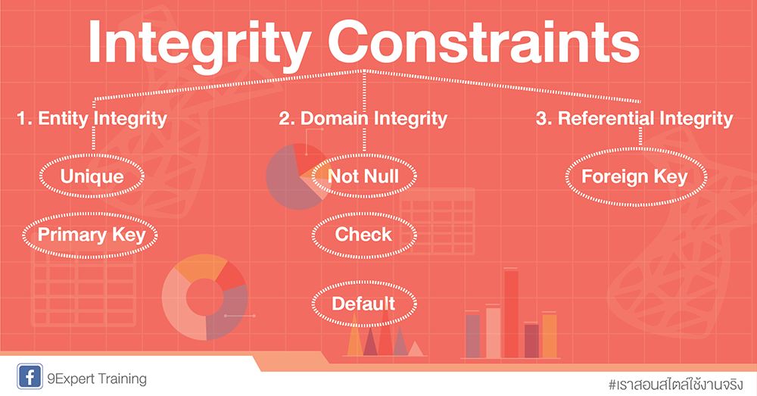
Types of Integrity Constraints
Required Data
Attribute Domain Constraints
Entity Integrity
Enterprise Constraints
Referential Integrity
Unique Key
Fig 5:Types of Integrity Constraints
(9experttraining, unknown)

Slide 19
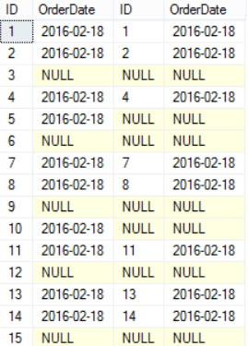
A. Required Data
Some attributes must always contain a value
they cannot have a NULL value
For example:
Every Customer must have a CustName
Every Employee must have a job title.
Every Order must have an order number and an item number

Slide 20
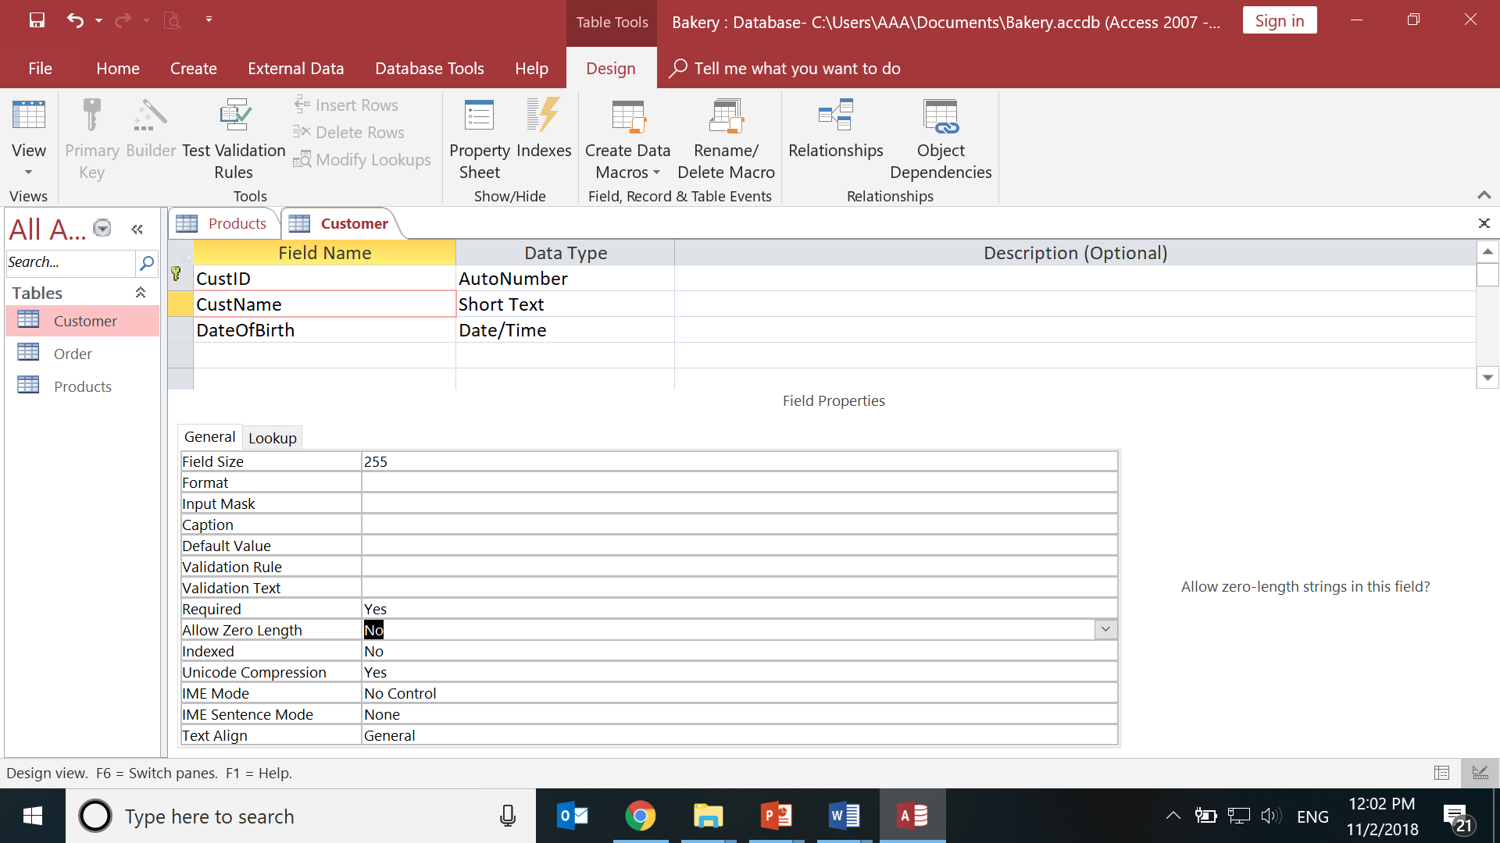
A. Required(contd..)
Goto Design View of Customer Table.
Click CustName
In the General Properties:
Set Required: Yes
Set Allow Zero Length: No

Slide 21
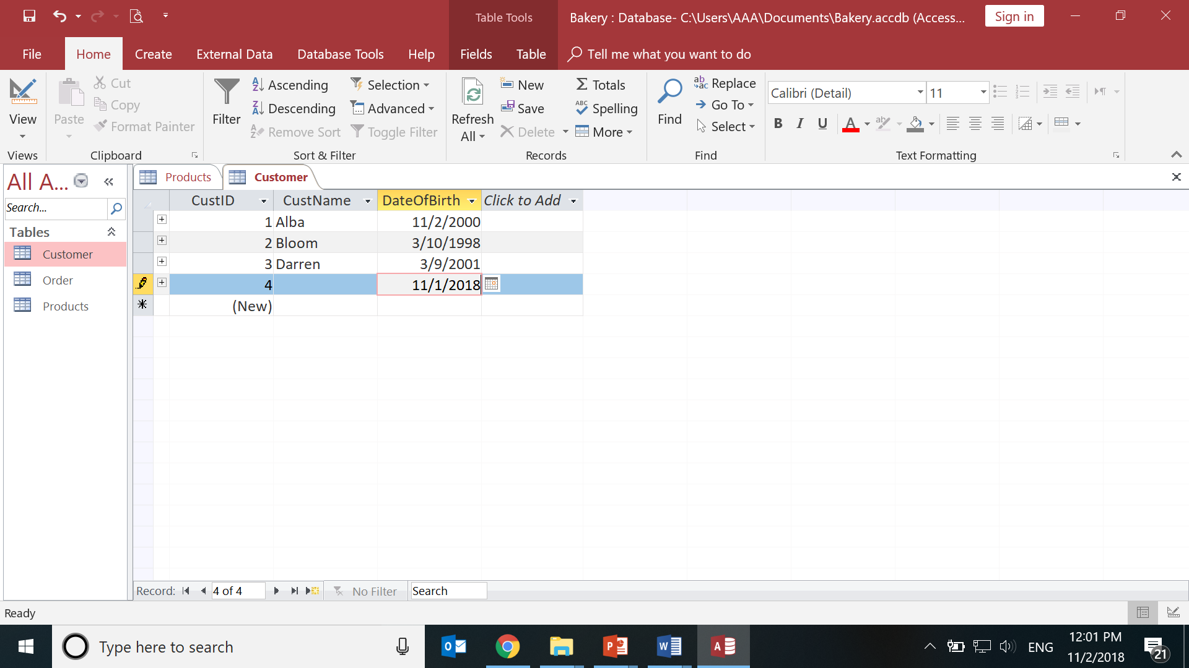
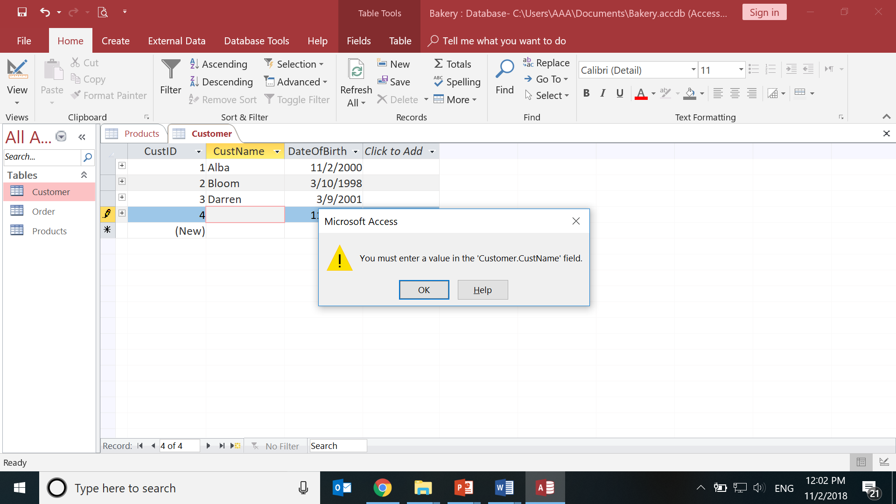
A. Required(contd..)
Double Click Customer table
Select Date
Keep CustName blank
Click save(or Cntrl+S)

Slide 22
B. Attribute Domain Constraints
Every attribute has a domain
Domain is a set of values that are allowed for it to use
For example:
The domain of gender in the Employee relation is
“M” or “F”

Slide 23
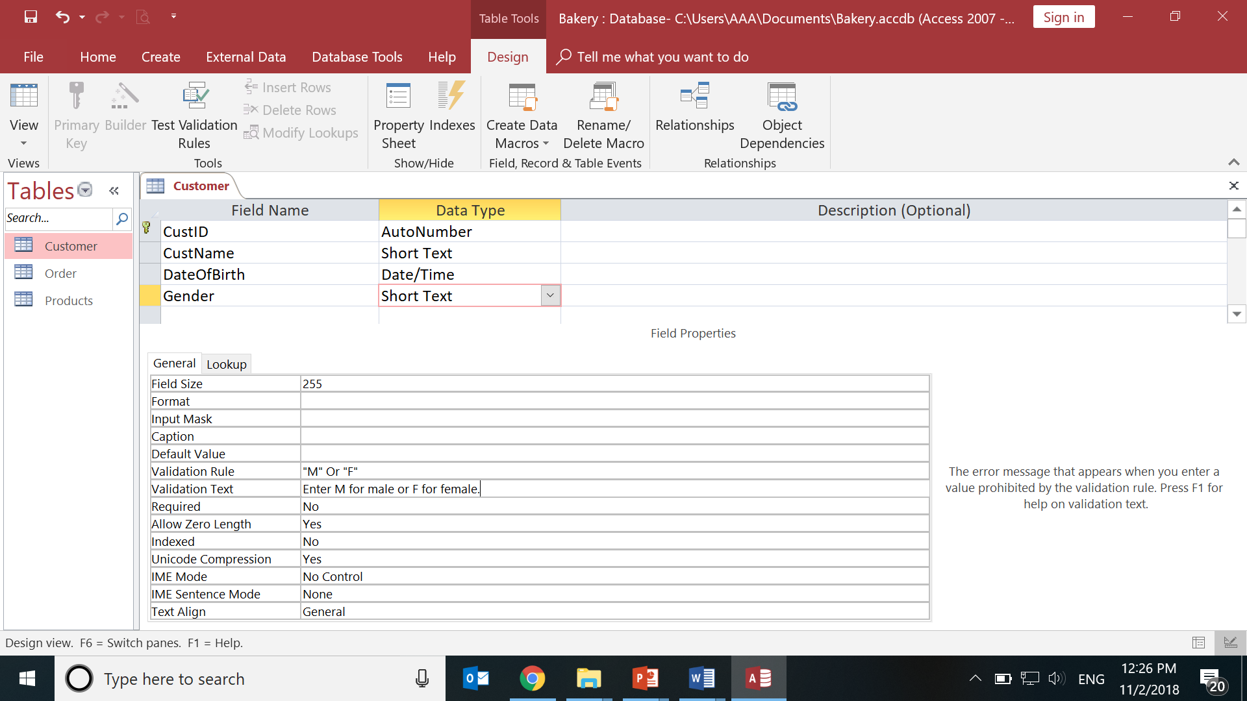
B.Domain Constraint (contd..)
Add a field Gender to Customer Table
Data Type: Short Text
In General properties type in for:
Validation Rule: M or F
Validation text:
Enter M for male and F for
Female
Save Table

Slide 24
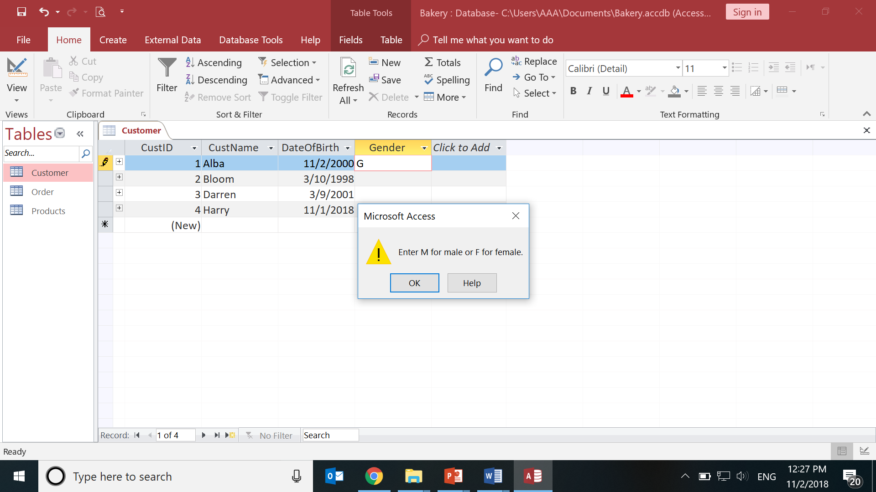
B.Domain Constraint (contd…)
Double Click Customer table to go to datasheet view
Enter Gender as G

Slide 25
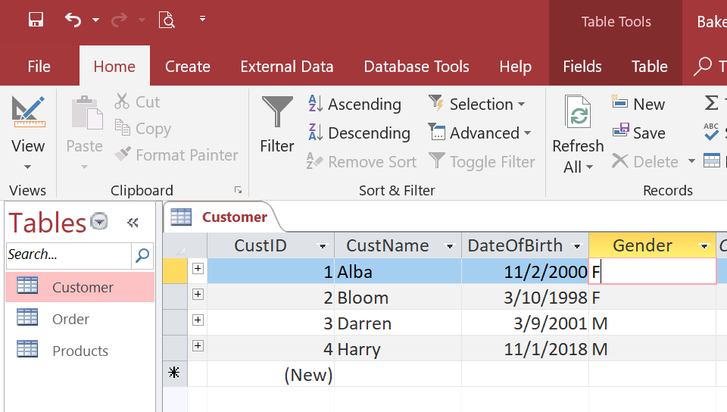
B. Domain Constraint(contd..)
Enter Correct Values for Gender

Slide 26
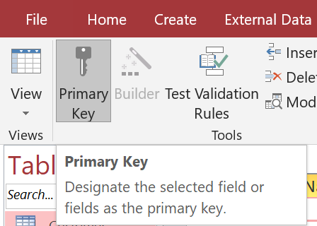
C. Entity Integrity
Primary Key Constraint
Primary key of any entity/ row:
Must be Unique
Cannot be NULL
Example:
CustID is primary key of Customer Table.
Activity:
Identify primary keys of other tables.

Slide 27
D. Enterprise Constraints
These are business rule that may affect the database and the data in it
Example,
Balance of a bank account cannot go below 500
Age of a movie customer cannot be < 18
ProductPrice cannot be less than 4

Slide 28
D. Enterprise Constraint (contd…)
Goto DesignView of Products
Select Prod_PricePer field
General Properties, Type:
Validation Rule:>4
Validation Text:
Price cannot be less than 4
Save table

Slide 29
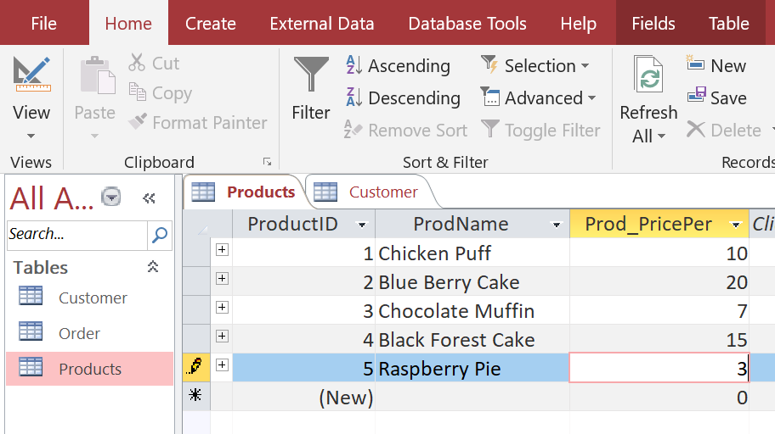
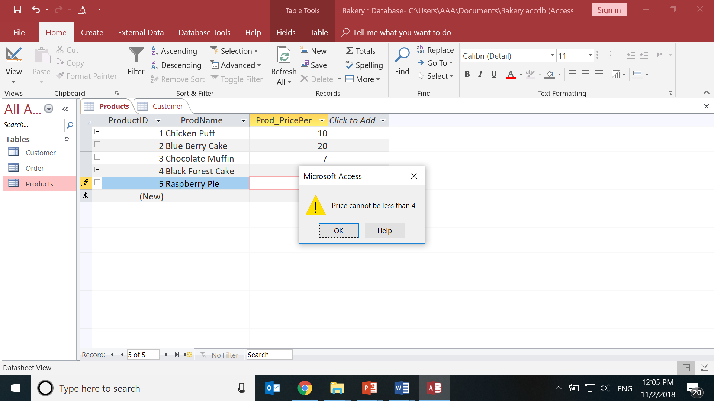
D. Enterprise Constraint (contd…)
Double click Products to go to Datasheet View
Input
ProdName:Raspberry pie Prod_PricePer:3
Save

Slide 30
E. Referential Integrity
Referential integrity refers to the accuracy and consistency of data within a relationship (Ian,2018).
When database tables are linked together, one table is usually called the Parent table and the other (the table that it is linked to) is called the Child.
In Parent table, the field is Primary Key
which is borrowed in Child Table as a Foreign Key
Referential Integrity means that whenever a foreign key value is used it must reference a valid, existing primary key in the parent table
Notes:
https://www.nevvb.com.au/Database-Referential-Integrity.aspx
https://database.guide/what-is-referential-integrity/

Slide 31
E. Referential Integrity (contd..)
Relation between Customers Table and Orders Table.
Customer places Order
Customer Table - CustomerID is a unique Primary Key
Orders table - CustomerID is a Foreign Key
Borrowed from Customer table.
in the relationship Customer places Order:
Customer Table is Parent table,
Orders table is Child table

Slide 32
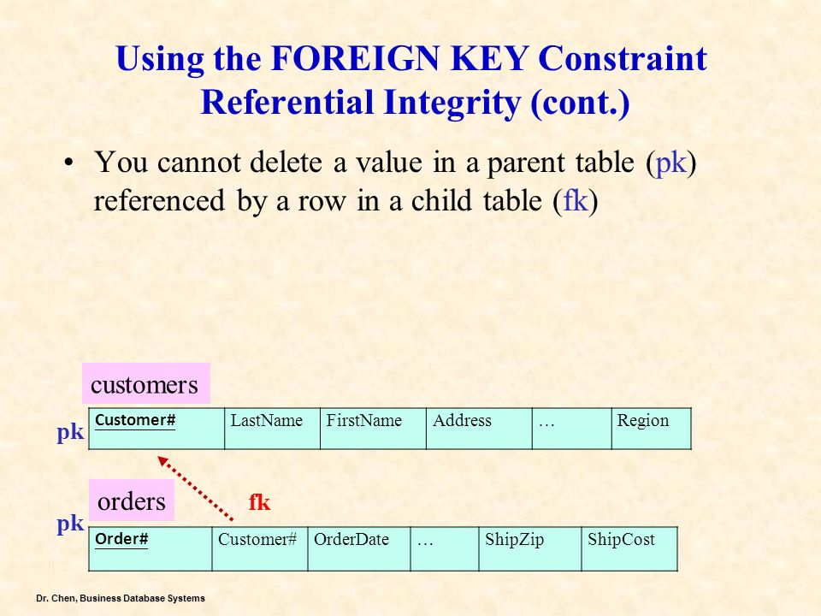
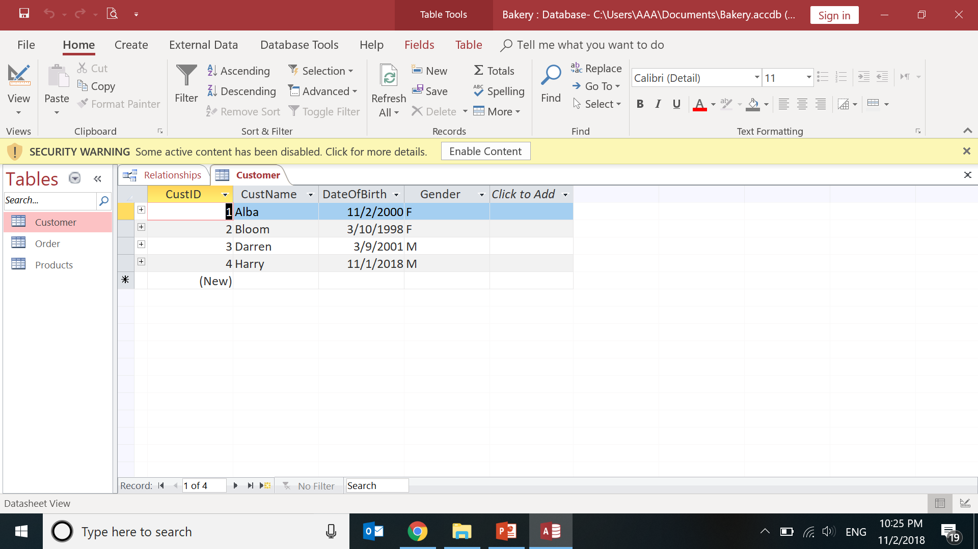
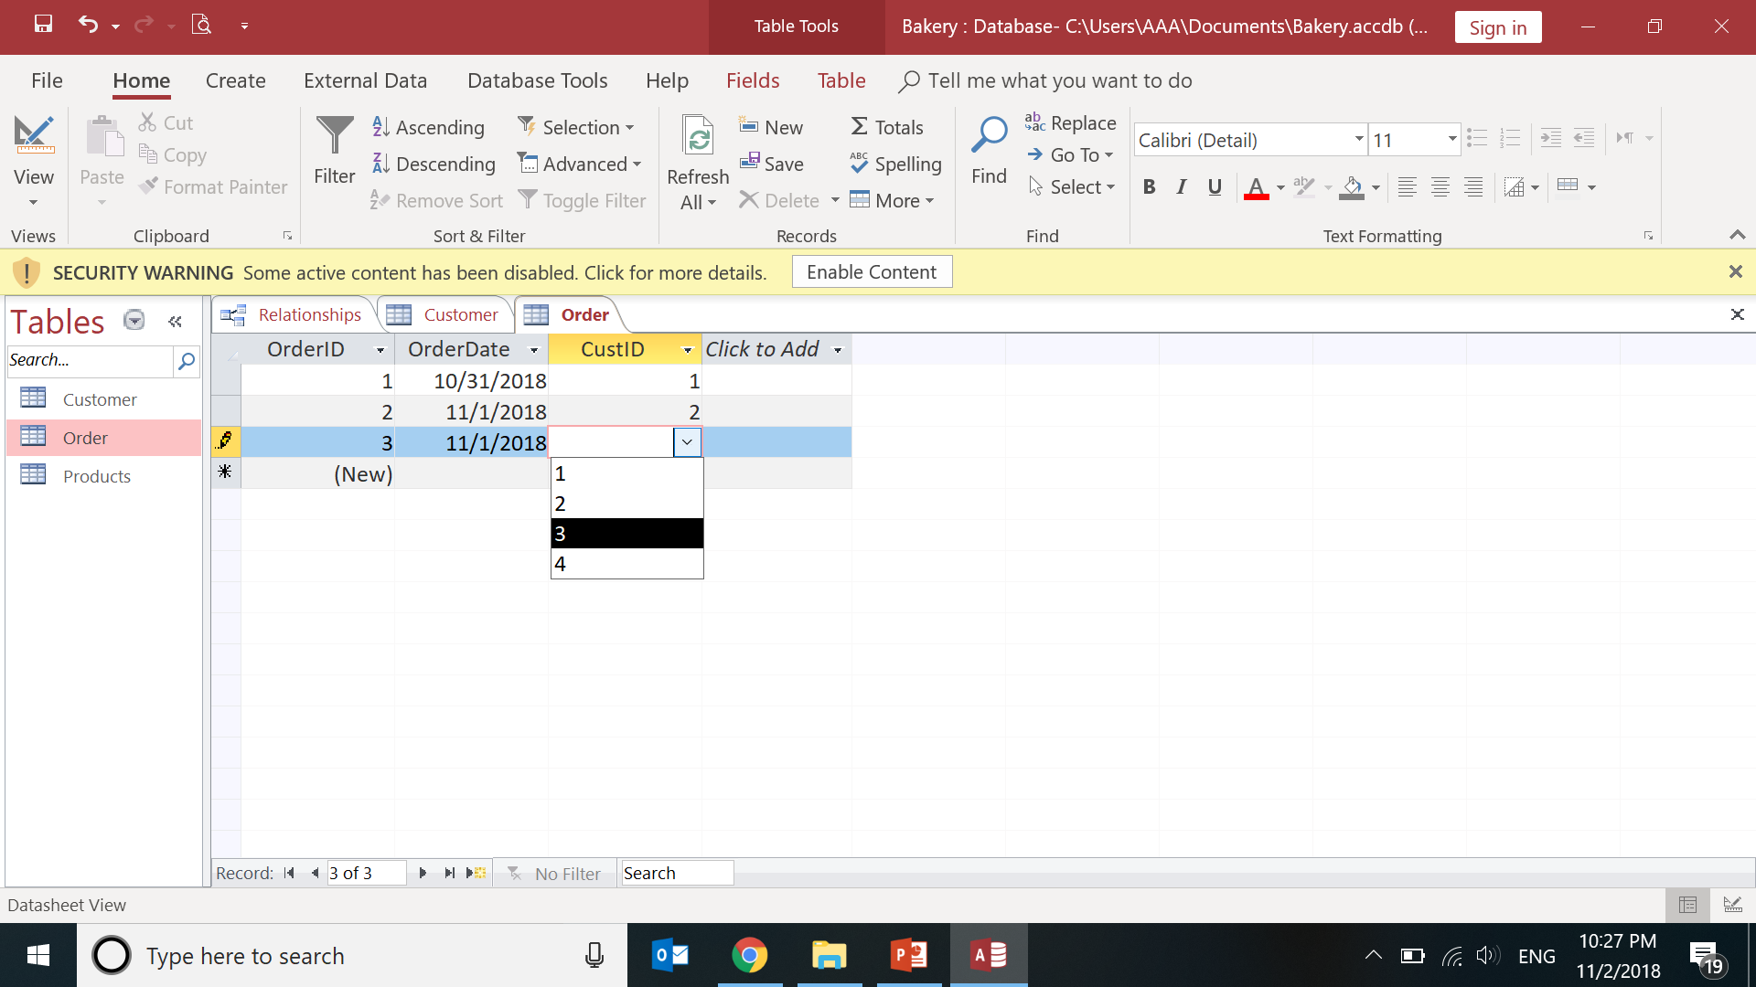
E. Referential Integrity (contd..)
Notes:
https://slideplayer.com/slide/7912569/
https://slideplayer.com/slide/6489099/
https://accessdatabasetutorial.com/microsoft-access-table-relationships/
https://slideplayer.com/slide/13264583/

Slide 33
E. Referential Integrity (contd..)
Disallow inserting any Order for a Customer that does not have a record in the Customers table.
Disallow modifying the CustomerID field for a record in the Customer table,
as this would break the link with related Order data for that
Customer.
Deleting a Customer record that has matching records in the Orders table would also not be allowed.

Slide 34
E. Referential Int -Insertion rules
A row should not be inserted in the referencing (child) table unless there already exists a matching entry in the referenced table

Slide 35
E. Referential Int - Deletion rules
A row should not be deleted from the parent table if there are matching rows in the child table
Three ways to handle this
Restrict -- disallow the delete X
Nullify -- reset the foreign keys in the child to some NULL or dummy value
Cascade -- Delete all rows in the child where there is a foreign key matching the key in the parent row being deleted

Slide 36
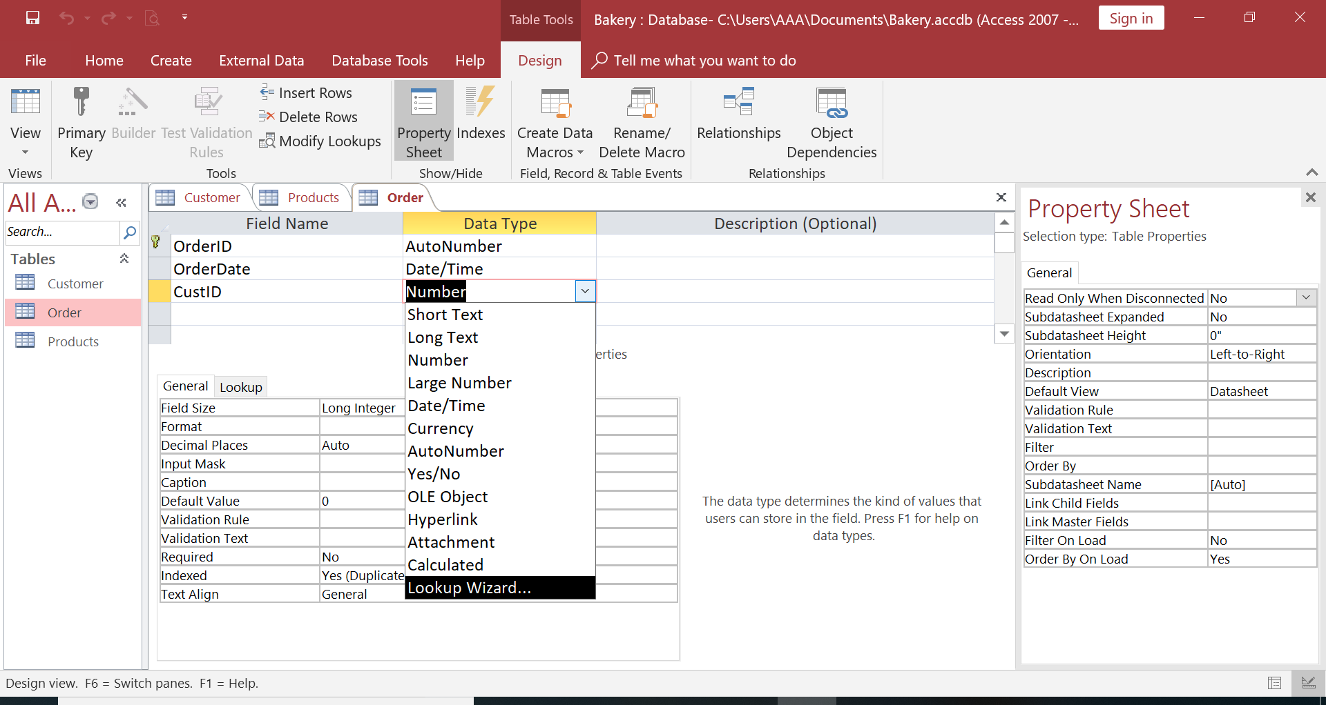
E. Referential Integrity(contd…)
Create Order Table
Create Fields:
OrderID: AutoNumber
OrderDate: Date/Time
CustID:
CustID DataType:
LookUp Wizard

Slide 37
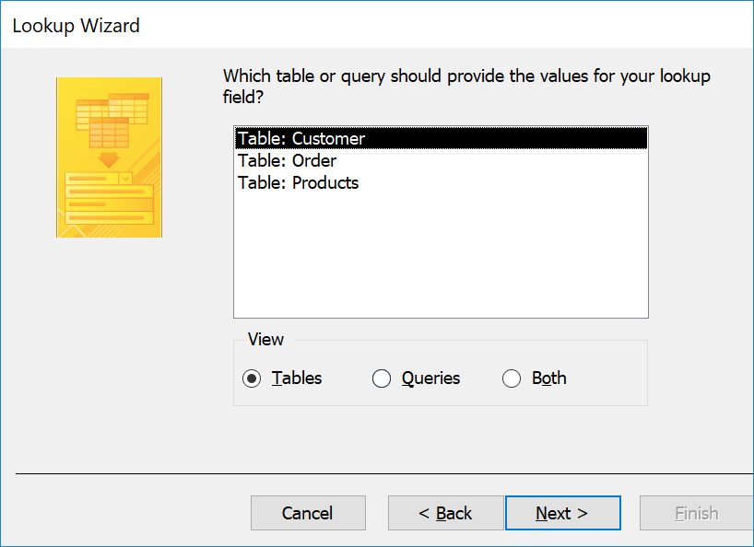
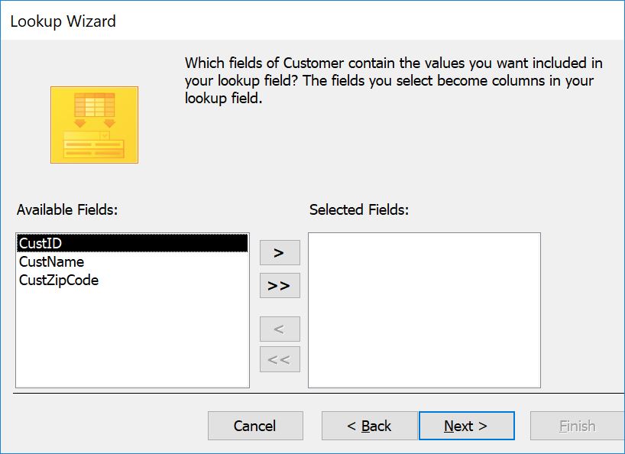
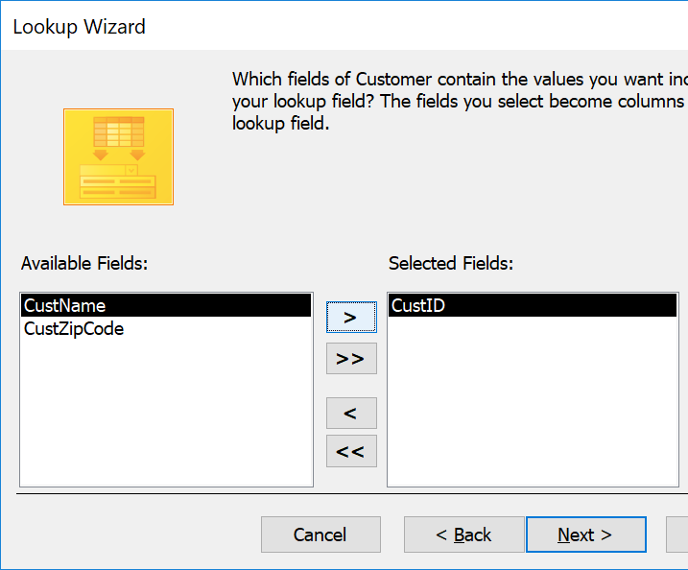
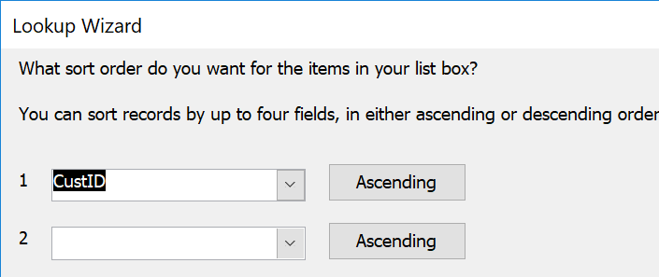
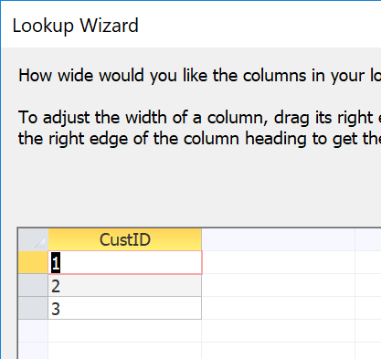
E. Referential Integrity(contd…)
Select Table: Customer
Click Next
Select CustID and click >
Select CustID

Slide 38
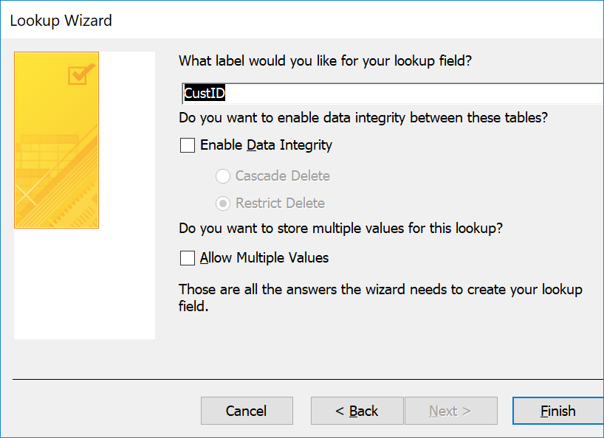
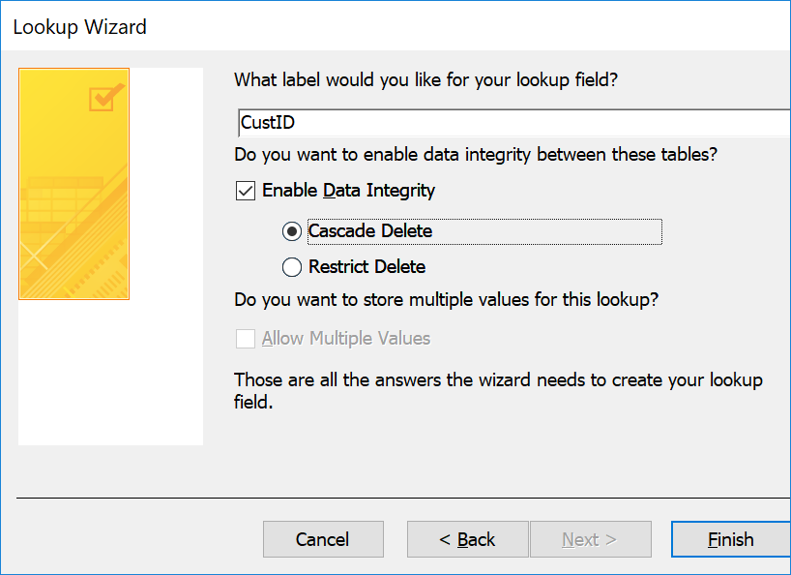
E. Referential Integrity(contd…)
Check Enable Data Integrity
Cascade Delete
Select

Slide 39
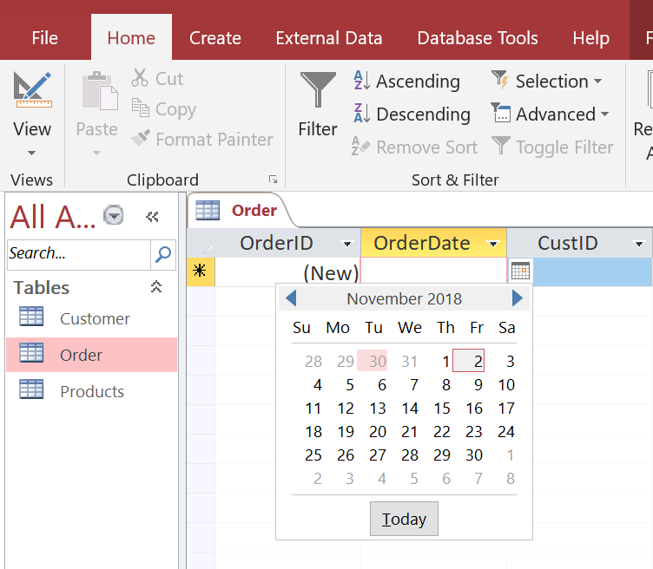
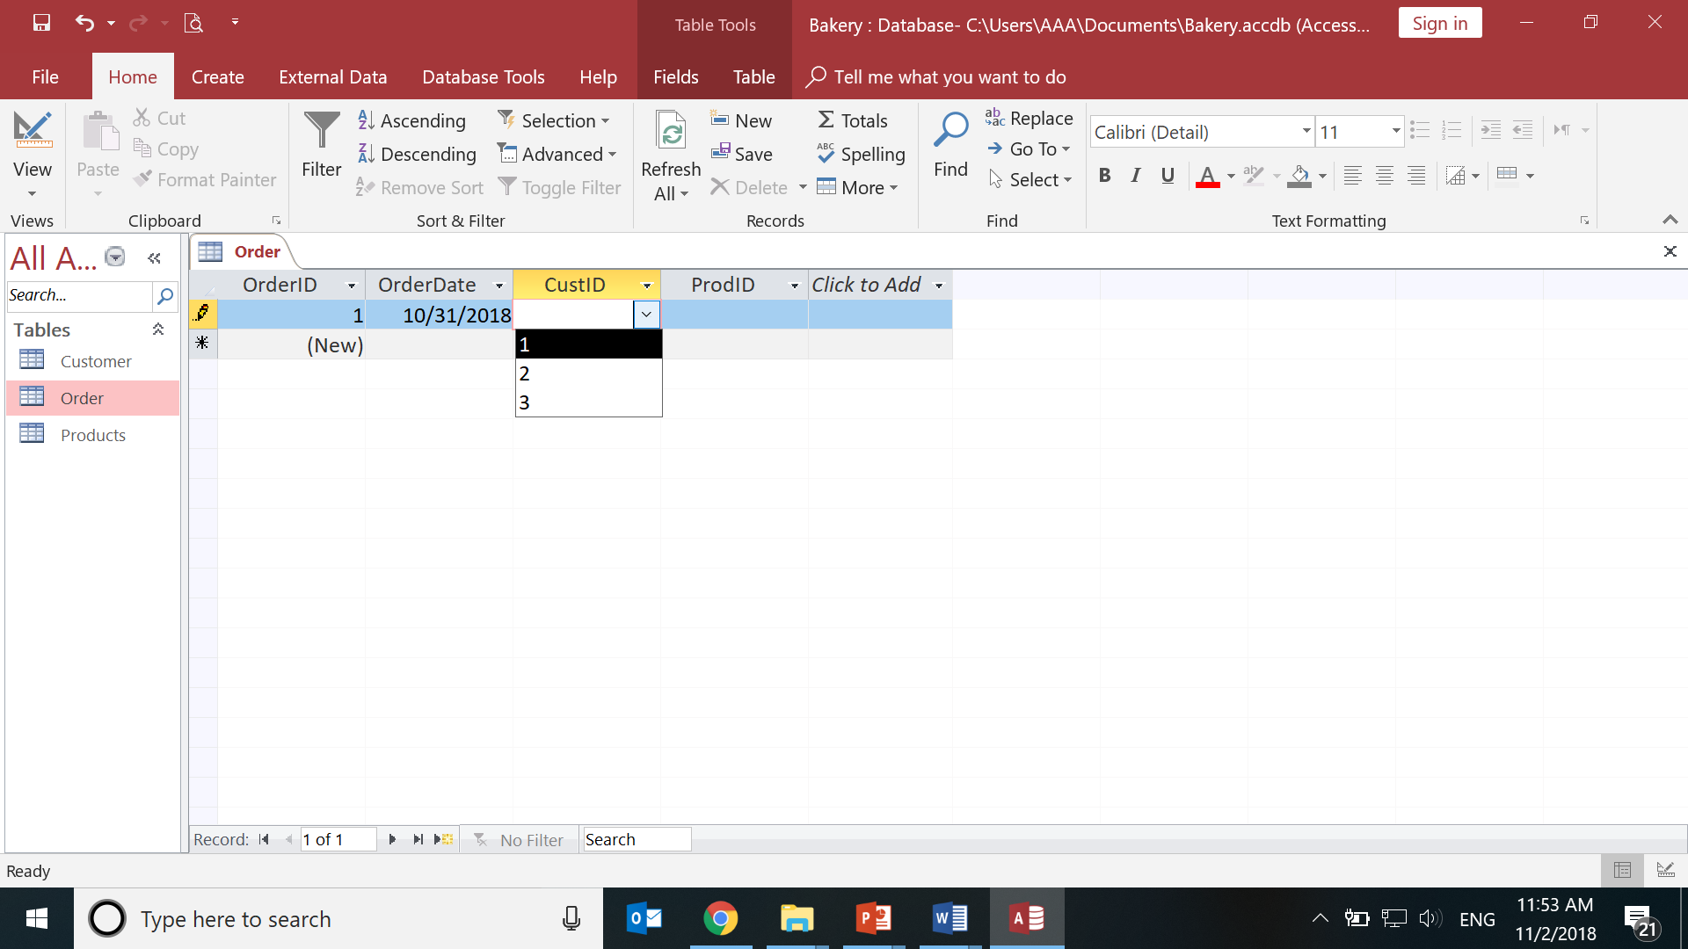
E. Referential Integrity(contd…)
Enter Details in Order Table

Slide 40
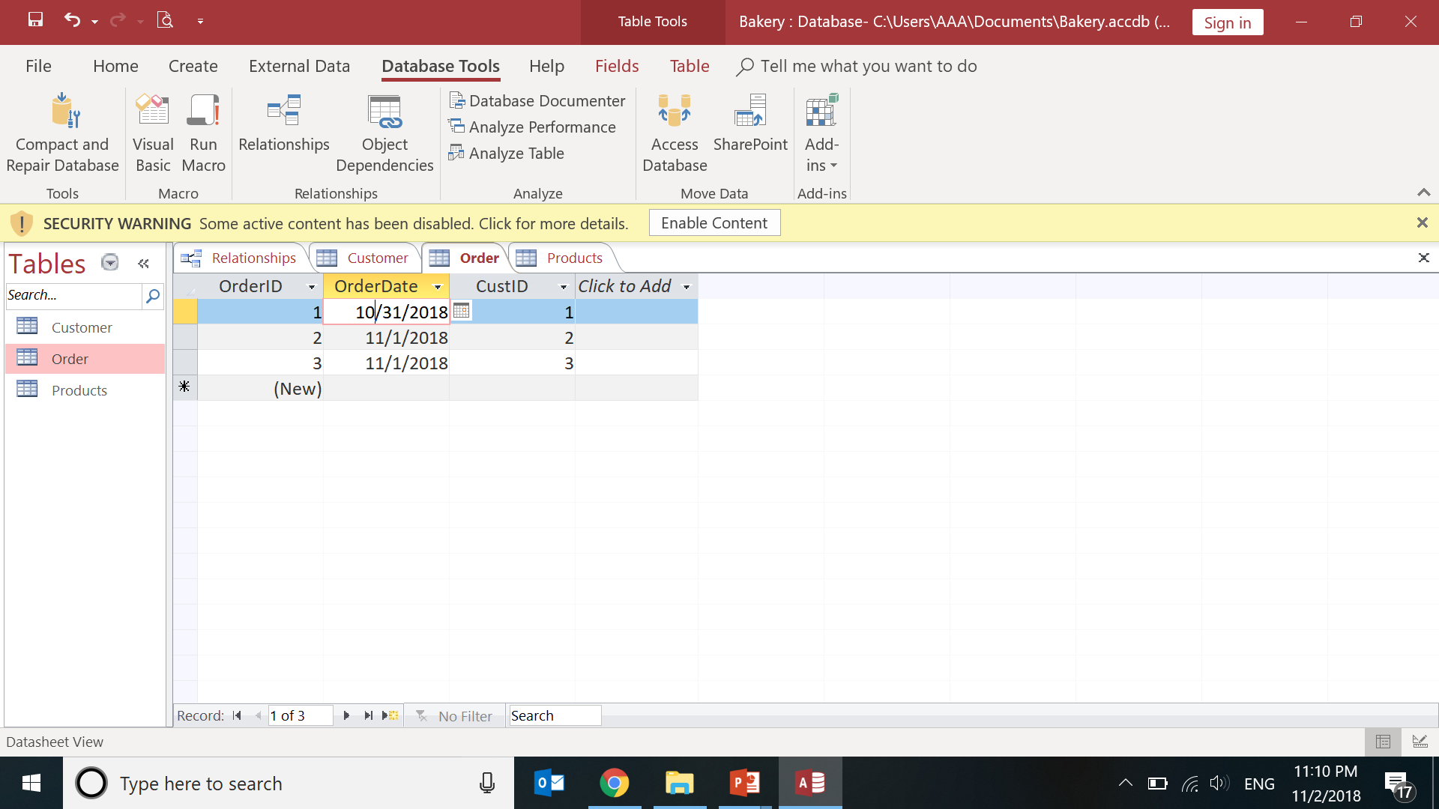
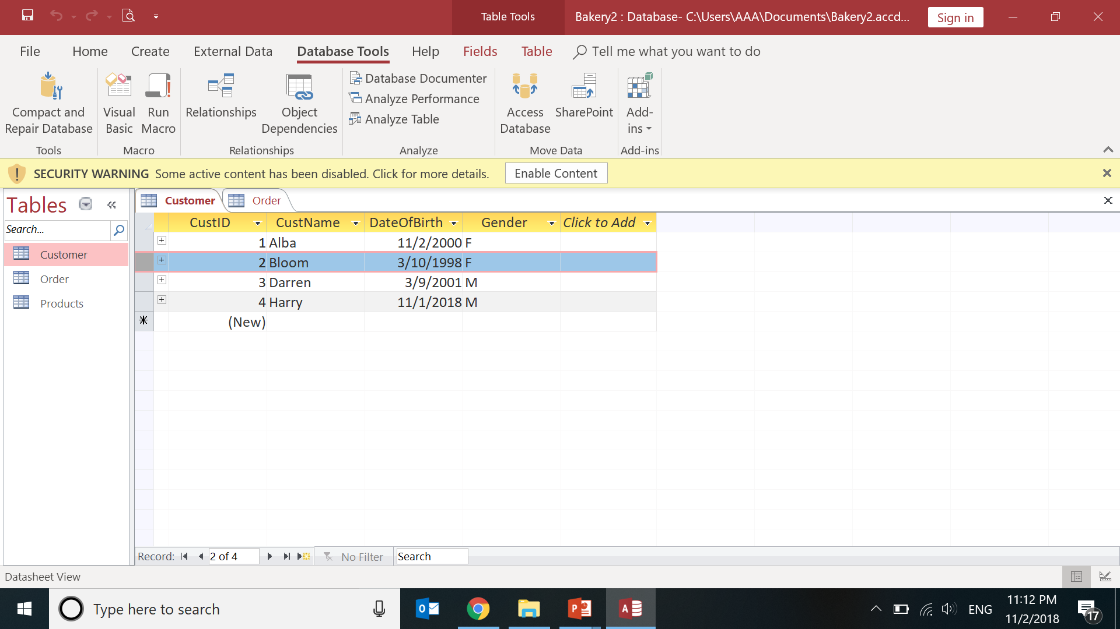
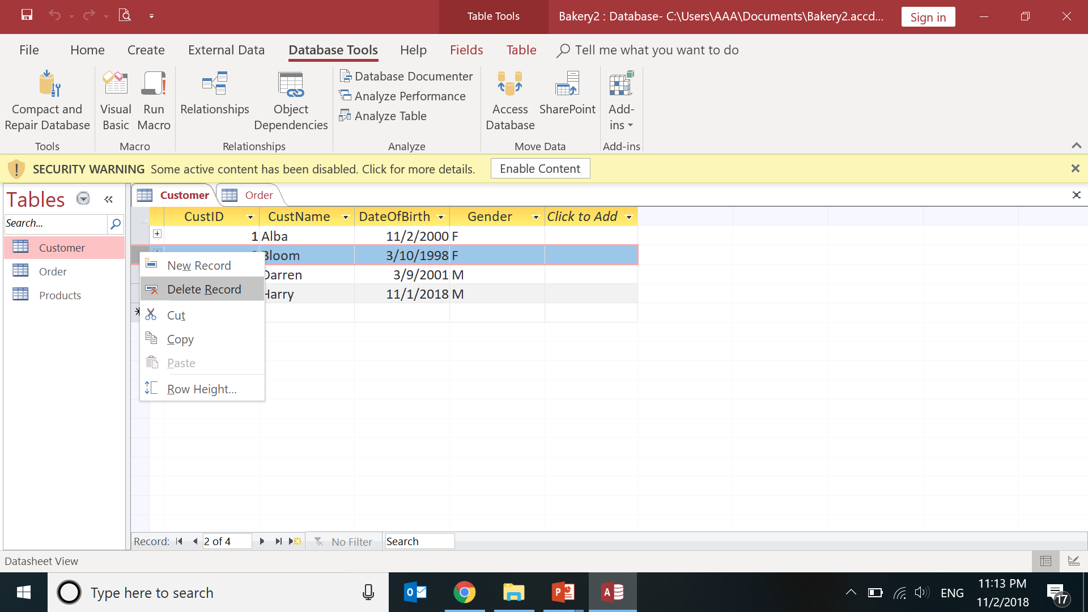
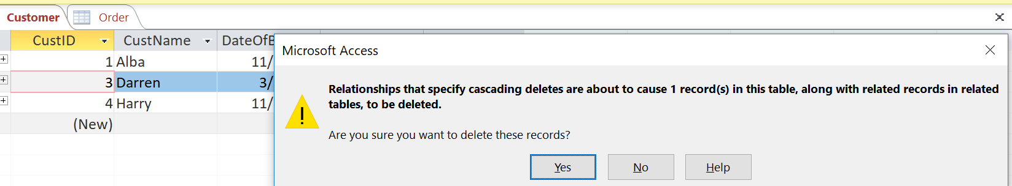
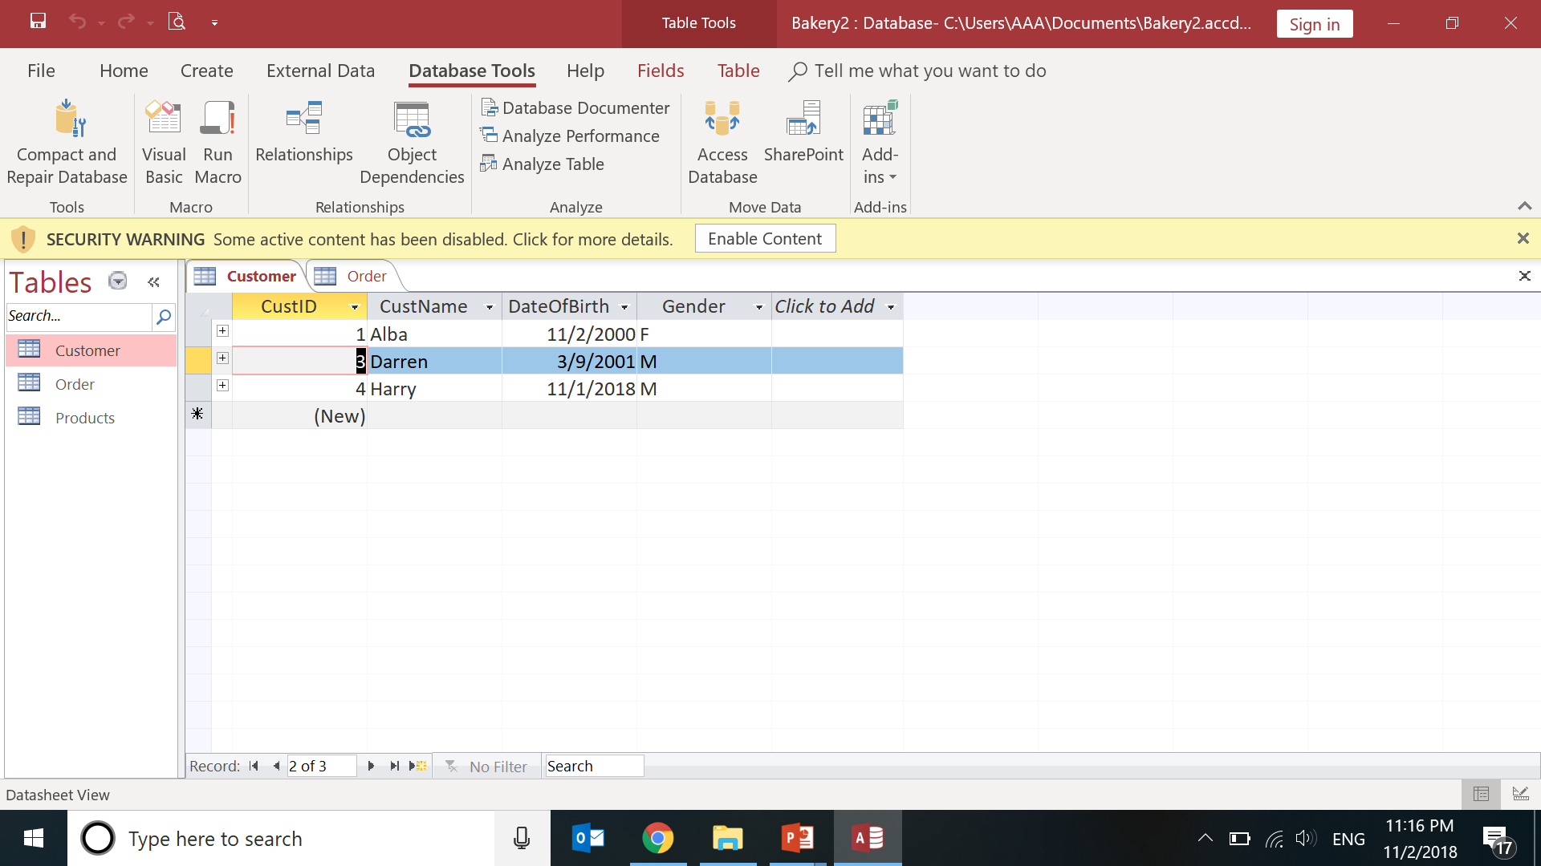

E. Referential Integrity(contd…)

Slide 41
Refrential Integrity Constraint in MSAccess, Cascade for Foreign Keys
Database Tools-> relationships->
Double click a relationship
Check the
Enforce Referential Integrity
Cascade Update
Cascade Delete

Slide 42
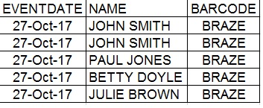
F. Unique Key Constraint
Oracle(2018) states
“A unique value rule defined on a column allows the insert or update of a row
only if it contains
a unique value in that column.”
(Value should not match any existing records)

Slide 43
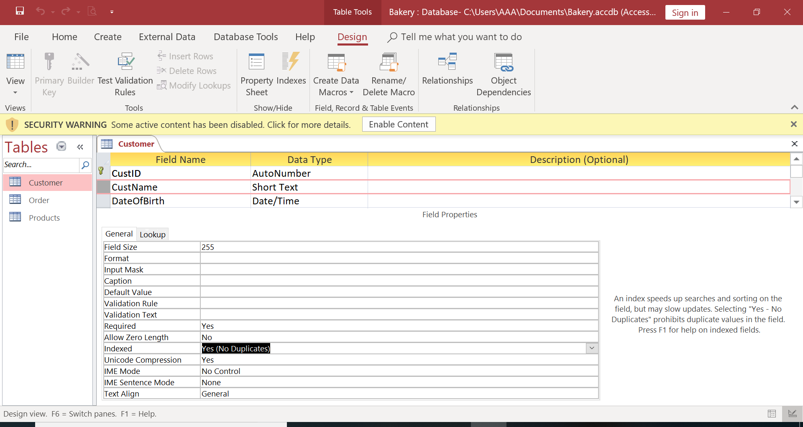
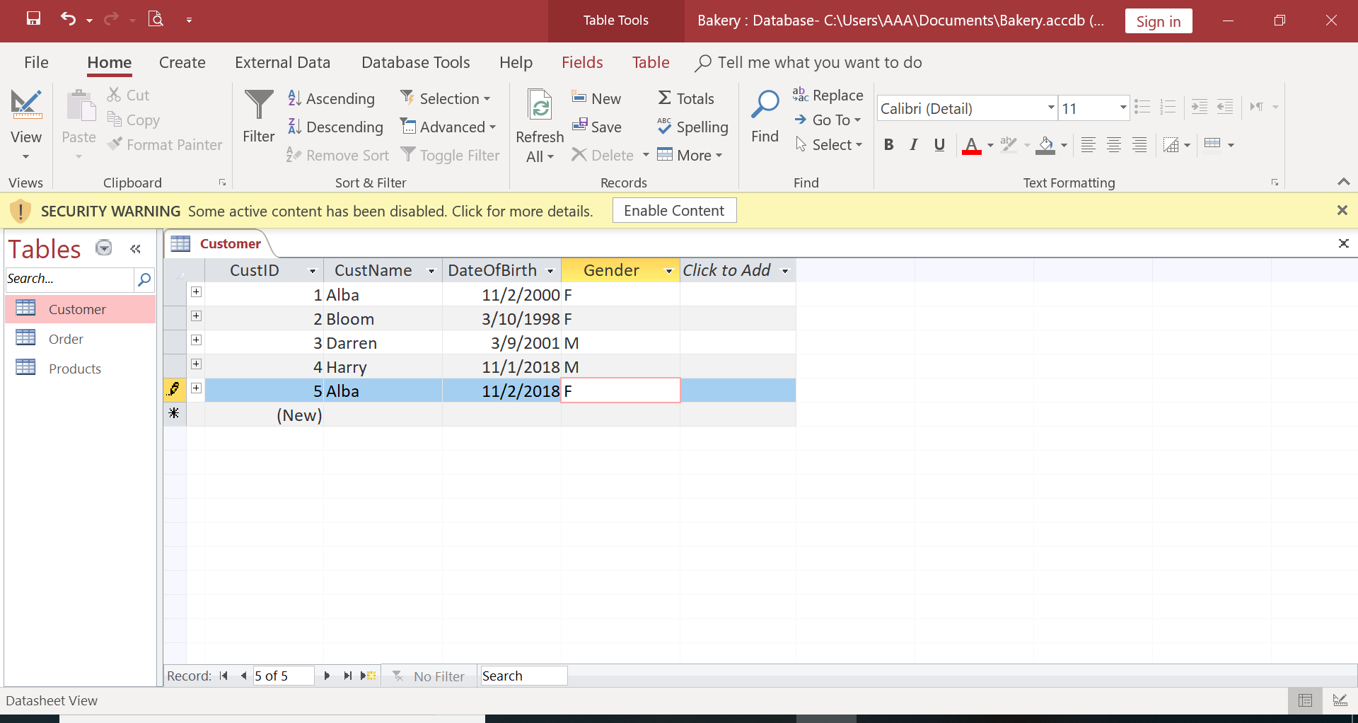
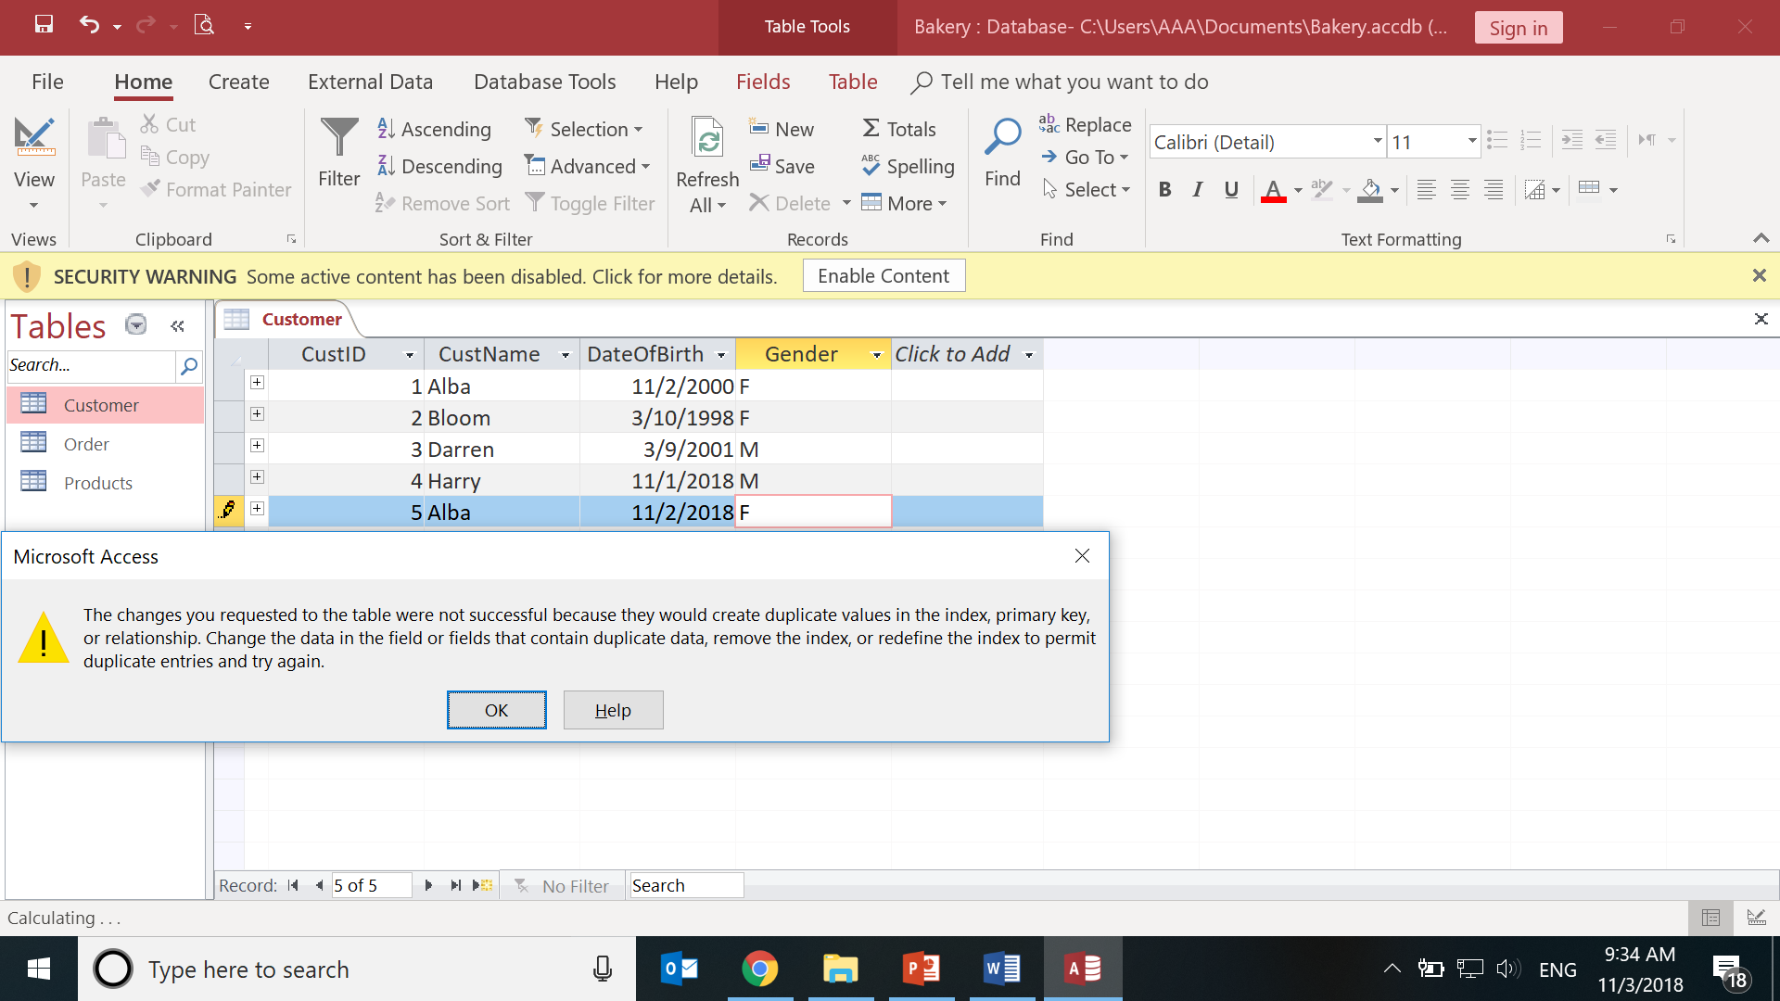
F. Unique Key Constraint (contd..)
Customer Table-Design
Select CustName.
General Properties, Indexed:
Yes(No Duplicates)
Double click Customer table
Name : existing customer
Click Save
Notes:
https://docs.oracle.com/cd/B19306_01/server.102/b14220/data_int.htm
https://stackoverflow.com/questions/5635811/unique-constraint-on-multiple-fields-in-access-2003

